Slide 1
Curbside Voting Site Station Guide Revised 2023

Slide 2

Curbside Procedures
1
Voter Greeting
2
Initial Photo ID Review
3
Examination of Photo and Name on Photo ID
4
Voter Status Review
5
Address Review
6
Party Affiliation Review
Curbside Steps

Slide 3
Curbside Procedures
7
Generate Vote Authorization Documents
8
Assemble Balloting Materials
9
Obtain Voter Signatures
10
Allow Voter to Mark Ballot
11
Accept Voter’s Ballot
Curbside Steps

Slide 4

Step 1: Voter Greeting
Ask the name of the person voting curbside
Determine if the voter requires assistance
Read oath to the voter and receive affirmation to confirm curbside eligibility
Complete a curbside log
Ask the voter to show a photo ID

Slide 5

Step 1: Voter Greeting
Ask the name of the person voting curbside
2
When approaching the curbside voting area, the curbside official must first determine who desires to vote from the vehicle. This can be accomplished by asking for the name of the person who is voting curbside.
If a person is unable to state their name because of an impairment, the curbside official may make reasonable accommodations, including asking the voter to write their name.
The voter may be able but unwilling to state their name. The curbside official will explain that the law requires voters to state their name aloud. If the voter continues to refuse to cooperate with the curbside official, the official will arrange for the voter to speak with an election judge.
Step 1: Voter Greeting
Curbside | 1

Slide 6
Step 1: Voter Greeting
Determine if the voter requires assistance
1
If a voter is in need of assistance, it must be requested. If a voter is accompanied when presenting to vote, a curbside official must determine if the voter wants assistance from someone in the vehicle. The voter may also ask for assistance from an election official.
Who may assist a voter?
A voter is entitled to assistance from a near relative: spouse, parent, child, brother, sister, grandparent, grandchild, stepparent, stepchild, mother-in-law, father-in-law, son-in-law, daughter-in-law
Who may receive voter assistance?
Disabled voters may receive the following forms of assistance from anyone except an agent of their employer or union representative:
Help entering the voting booth due to physical disability or blindness
Assistance in marking the ballot due to physical disability, illiteracy, or blindness
Step 1: Voter Greeting
Curbside| 2

Slide 7
Step 1: Voter Greeting
Election officials should follow the script below to determine if a voter is entitled to assistance:
1. Ask the voter: “Is this person here to assist you?”
a. If YES, go to question 2.
b. If NO, instruct the person that they need to wait outside the voting enclosure.
2. Ask the voter: “Is this person a near relative?” Refer to explanation of who can assist a voter.
a. If YES, the voter may receive assistance. No further information is needed.
b. If NO, go to question 3.
3. Say: “A voter who needs assistance because the voter is blind, disabled, or unable to read, speak, or write English may receive assistance from a person of the voter’s choice. Do you need assistance for one of these reasons?”
a. If YES, go to #4.
    b. If NO, the voter is not entitled to receive assistance from someone who is not a near relative. If requested by the voter, an assistant, judge, or chief judge may assist the voter.
4. Ask the voter: “Is this person your employer, your employer’s agent, an officer of your union, or an agent of your union?”
    a. If YES, the person may not assist the voter. The voter may select someone else to assist him or her. If requested by the voter, an assistant, judge, or chief judge may assist the voter.
b. If NO, the voter may receive assistance. No further information is needed.
entering the voting booth due to physical disability or blindness,
assistance in marking the ballot due to physical disability, illiteracy, or blindness
Step 1: Voter Greeting
Curbside |3

Slide 8
Step 1: Voter Greeting
Read oath to the voter and receive affirmation to confirm curbside eligibility
The curbside official can determine eligibility by giving the voter the curbside oath and receiving a response that the voter will be able to sign the curbside affidavit.
Do you solemnly swear (or affirm):
that you are a registered voter in this_________ precinct?
that because of age or physical disability you are unable to enter the voting place to vote in person without physical assistance?
that you desire to vote outside the voting place and enclosure?
and you understand that a false statement as to your condition will be in violation of North Carolina law?
If the voter swears or affirms, continue with the curbside check-in procedures.
If the voter cannot swear or affirm to the curbside oath, the voter must be instructed to vote inside the voting enclosure. disability or blindness,
assistance in marking the ballot due to physical disability, illiteracy, or blindness
Step 1: Voter Greeting
Curbside |3

Slide 9
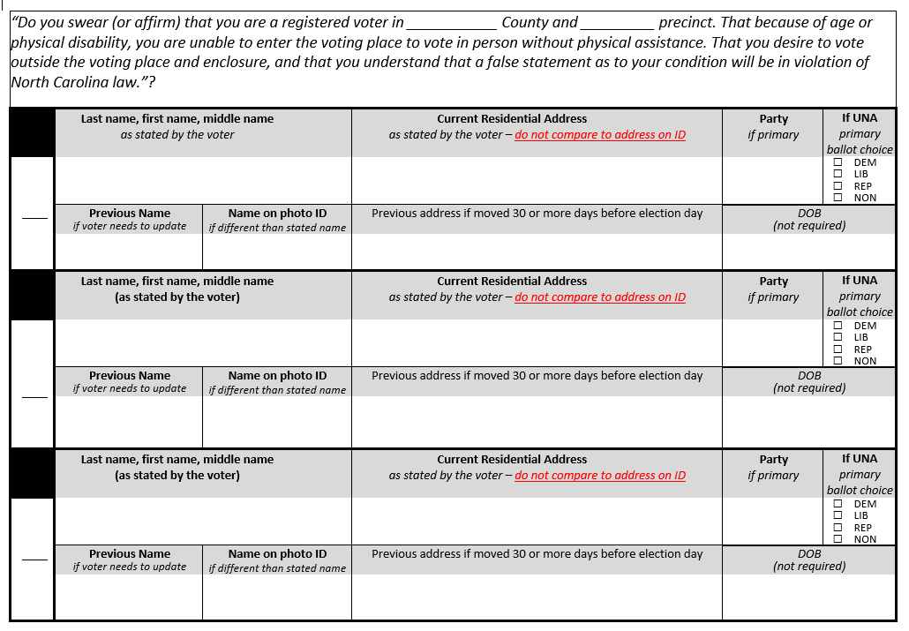
Notes:
Begin your curbside log with information provided by the voter including:
Name as stated by the voter
Current residential address as stated by the voter
Party (in a primary)
If UNA ballot choice (in a primary)
Previous name or address
ONCE YOU HAVE REQUESTED THE ID YOU CAN INCLUDE THE NAME ON THE PHOTO ID

Slide 10
Step 1: Voter Greeting
Request the Voter’s Photo ID
(you do not need to take the photo ID into the voting enclosure)
NC law requires a voter to show an acceptable form of photo ID or to sign a form claiming an exception (the Photo ID Exception Form).
If a voter says they forgot their ID, ask them if they can easily retrieve it. If they cannot, they must be informed of the options for voting a provisional ballot without an ID.
The following circumstances require the curbside official to inform the voter of the options for voting a provisional ballot without an ID:
If a voter does not show photo ID due to some difficulty that prevents the voter from presenting a photo ID (a “reasonable impediment”)
If a voter simply refuses to show a photo ID
If a voter does not show photo ID due to a religious objection to being photographed
If a voter does not show photo ID because they are a victim of a recent natural disaster
If a voter needs to cast a provisional ballot, please follow the procedures in step 7 and 8.
Step 1: Voter Greeting
Curbside |3

Slide 11
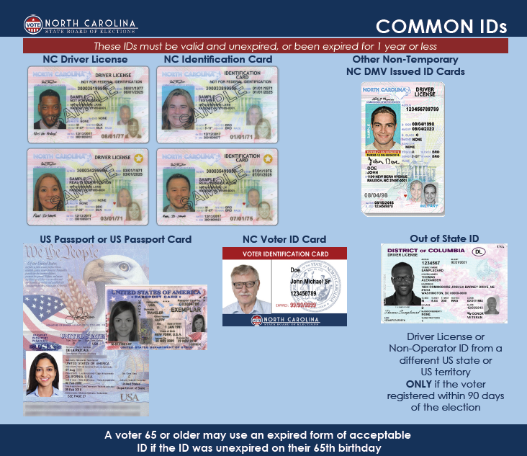
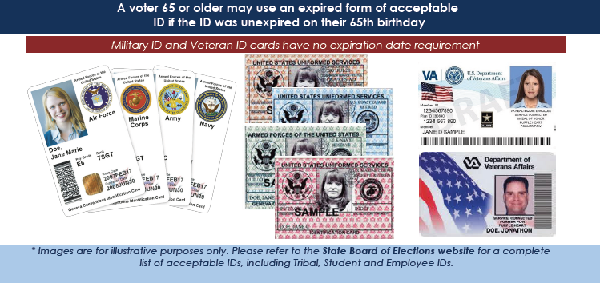
Request the Voter’s Photo ID
(you do not need to take the photo ID into the voting enclosure)
The curbside election official should use the list of Acceptable Photo IDs for Voting in 2023 and the Common ID Flyer to confirm that the photo ID presented is an acceptable type of ID.

Slide 12
Step 2: Initial ID Review
Inspect the photo ID
Determine if the photo ID is an acceptable type
Determine if the photo ID meets expiration requirements
Determine if the photograph on the photo ID reasonably resembles the person presenting to vote

Slide 13
Step 3: Evaluation of the Name on the Photo ID
Return ID to voter and proceed to check in station
Determine if the name on the photo ID is the same as or substantially equivalent to the name on the voter record (Electronic or Paper List)
Make a final determination that the photo ID meets all requirements

Slide 14
After Making a Final Determination on the Photo ID
If the curbside election official determines that the photo ID meets all requirements, then proceed to the next step.
If the official finds that the photograph on the photo ID does not bear a reasonable resemblance to the person presenting to vote or that the name on the ID is not the same as or substantially equivalent to the name on the voter record, then the official must inform the voter of the reasons the election official made the determination and invite the person to provide any other acceptable photo ID that they may have.
If the voter does not offer another type of acceptable photo ID, the curbside official must enter a challenge immediately notify the judges of election by using the help referral form. The judges will conduct the challenge hearing at the curbside voting location, and the judges may separately visit the curbside location to review the evidence.
Step 3: Evaluation of the Photo and Name on the Photo ID
Curbside |

Slide 15
Step 4: Voter Status Review
Determine the voter’s registration status
Determine whether there are voter status issues that need to be resolved before a ballot can be issued

Slide 16
Step 5: Address Review
Remember, the address on a voter’s photo ID for is not required to match the address on the voter’s record.
Compare address provided on the curbside log with address on voter record

Slide 17
Step 6: Party Affiliation Review
This step is for partisan primaries only
Compare party information provided on the curbside log with party on voter record

Slide 18
Step 7: Generate Vote Authorization Documents
If the voter is registered and qualified to vote: obtain their vote authorization document from Check-in
If the voter cannot be issued a regular ballot: obtain a provisional voting application from the Help Station

Slide 19
Step 8: Assemble Balloting Materials
Regular Ballot
• ATV or one-stop application
• Privacy sleeve
• Ballot
Provisional Ballot
• Provisional Voting Application
• Privacy sleeve
• Ballot
• Provisional envelope
• Photo ID Exception Form (if applicable)
• Provisional voter instructions

Slide 20
Step 9: Obtain Voter Signatures
Review the document(s) with the voter
to ensure the information on the form(s)
is correct
Indicate areas on the relevant form(s) that require the voter’s signature
Allow the voter to sign the document(s)
Collect the document(s)

Slide 21
Step 10: Allow Voter to Mark Ballot
Provide the voter with the balloting materials and voting instructions
Provide voter with instructions on how to indicate they have completed
voting
Monitor curbside area to ensure vehicle is not approached by electioneers

Slide 22
Step 11: Accept Voter’s Ballot
If regular ballot: deliver ballot in privacy sleeve to a judge of election to cast ballot and deliver the signed vote authorization document(s) to the Ballot Station
If provisional ballot: deliver ballot sealed in the provisional envelope along with form(s) to the Help Station Official

